Slide 1
Dataverse Common Use Cases & Comparison
Common Use Cases
Comparison
 | Category | Complexity | Data Structure | App Type | Why?
Kudos for the team | Team Initiative | Low | SharePoint Dataverse for Teams | Canvas App | Not highly relational, data will grow over time. Not sensitive data (simple security model). Very mobile. Low traffic.
Simple calculator | Individual Productivity | Low | SharePoint Excel | Canvas App | Not highly relational. Typically replacing an Excel file and making a calculator mobile friendly and accessible. Not sensitive data (simple security model). Low traffic.
Company news | Organization Wide Initiative | Medium | SharePoint | Canvas App | Not highly relational. Simple security structure (read only for the org, with few contributors). Not sensitive data. High traffic.
Task logging | Simple Business Application | Medium | Dataverse | Canvas or Model | Highly relational. Auditability. Process Management. Sometimes front-end canvas, mid office model driven app. Complex or hierarchical security model.
Health and safety questionnaire | Complex Business Application | High | Dataverse SQL | Canvas or Model | Business Process Flows, Security, Auditability. Highly relational data with multiple references to other tables. Complex data structure, complex security structure.
Vendor submitting certificates or permits | Basic Business Application | Medium | Dataverse | Portal | External access through B2B or other authentication. Complex security structure.
 | SharePoint Lists | Dataverse for Teams | Dataverse | On Premises Data | Azure SQL
Maximum data capacity | 25 TB per site collection limits when accessing and operating on lists in an app | 2 GB per environment no option to increase but can upgrade to Dataverse environment | 4 TB per environment | - | 100 TB
Hierarchical security | None | None | Out of the box via Business units | - | Customization
Field level security | None | None | Out of the box | - | Out of the box
Who will create and manage the app and data model? | Business | Business | Business or IT | IT | IT
Data model complexity | Simple or flat | Simple or complex | Simple or complex | Complex | Very complex
Platform | PaaS | SaaS | SaaS | - | PaaS
Advanced analytics and reporting | Simple reporting on non-real time data. Refresh is on a schedule. | Direct Query with security trimming and near real-time updates. | Connects to Data Lake Gen 2 for advanced analytics. Direct Query with security trimming and near real-time updates. | - | Direct Query available for near real-time update.
Microsoft Proprietary and Confidential

Slide 2
Dataverse Feature Comparison
Type | Features | Dataverse for Teams | Dataverse
Scenario | Easily build apps, workflows, and chatbots in Teams, leveraging Teams infrastructure. | ✓ | ✓
 | Leverage all of Power Platform’s client, connectors, governance, storage, data, and pro-developer capabilities |  | ✓
Table and Data Storage | Basic Data types, Relational storage, File and image support, Find, Filter, Sort, Dataflows in | ✓ | ✓
 | Advanced data types, Non-relational storage, Managed data lake, Mobile offline, virtual entities, Advanced and relevance search, server-side sync, Synapse Integration (Bring Your Own Data Lake, Data Factory), Dataflows out |  | ✓
Business intelligence and Pro Dev | Data Visualization | ✓ | ✓
 | Paginated reports. API access. Plug-ins | ✓ | ✓
 | REST API, Software Development Kit (SDK) |  | ✓
Security | System administrator, Basic team structure, share app with Azure AD group | ✓ | ✓
 | Admin, Custom security roles, Business units (multiple) Activity logging, Auditing, Field-level security, Hierarchical security, Record Sharing, Customer managed keys, WS-Trust/Legacy AuthN | ✓ | ✓
 | Robust options to satisfy complex enterprise scenario requirements |  | ✓
Integration | Power Automate | ✓ | ✓
 | Export to Azure data lake, Data export service, Events to Azure Event hubs, Event to Azure, services bus, Webhooks, Server-side sync, SQL server management studio, API access, Plug-ins |  | ✓
 | Common Data Model | User table only | ✓
Reporting | Data visualization, Power BI (coming soon) | ✓ | ✓
 | Paginated reports (SSRS) |  | ✓
License Type | See licensing guide for more details – https://aka.ms/DataverseFT_Licensing | Most Microsoft 365 licenses | Premium Power Platform and/or Dynamics 365 licenses
Capacity | Up to 1M rows, limited files and images, 2,000 API Calls per day per user, 2 GB for Teams environment | ✓ | Fewer limits
 | No specified row limit, now specified limit on files and images, 2,000 API Calls AND option of capacity add-ons, 4 TB per environment |  | ✓
Clients | Teams, Web, Mobile (Power Apps/D365 Player), Desktop, Microsoft Outlook, Microsoft Excel, Power Apps, Power Apps portals, Custom code | Teams only | ✓
Additional Capabilities | Business rules, business process flows, business workflows, calculations and rollups, mobile offline |  | ✓
Environment Lifecycle | Backup, Point-in-time restore, Disaster recovery | ✓ | ✓
App Lifecycle | Managed and Unmanaged Solutions | 1 unmanaged solution per Team | ✓
Microsoft Proprietary and Confidential

Slide 3
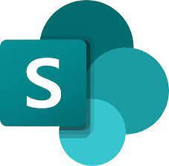
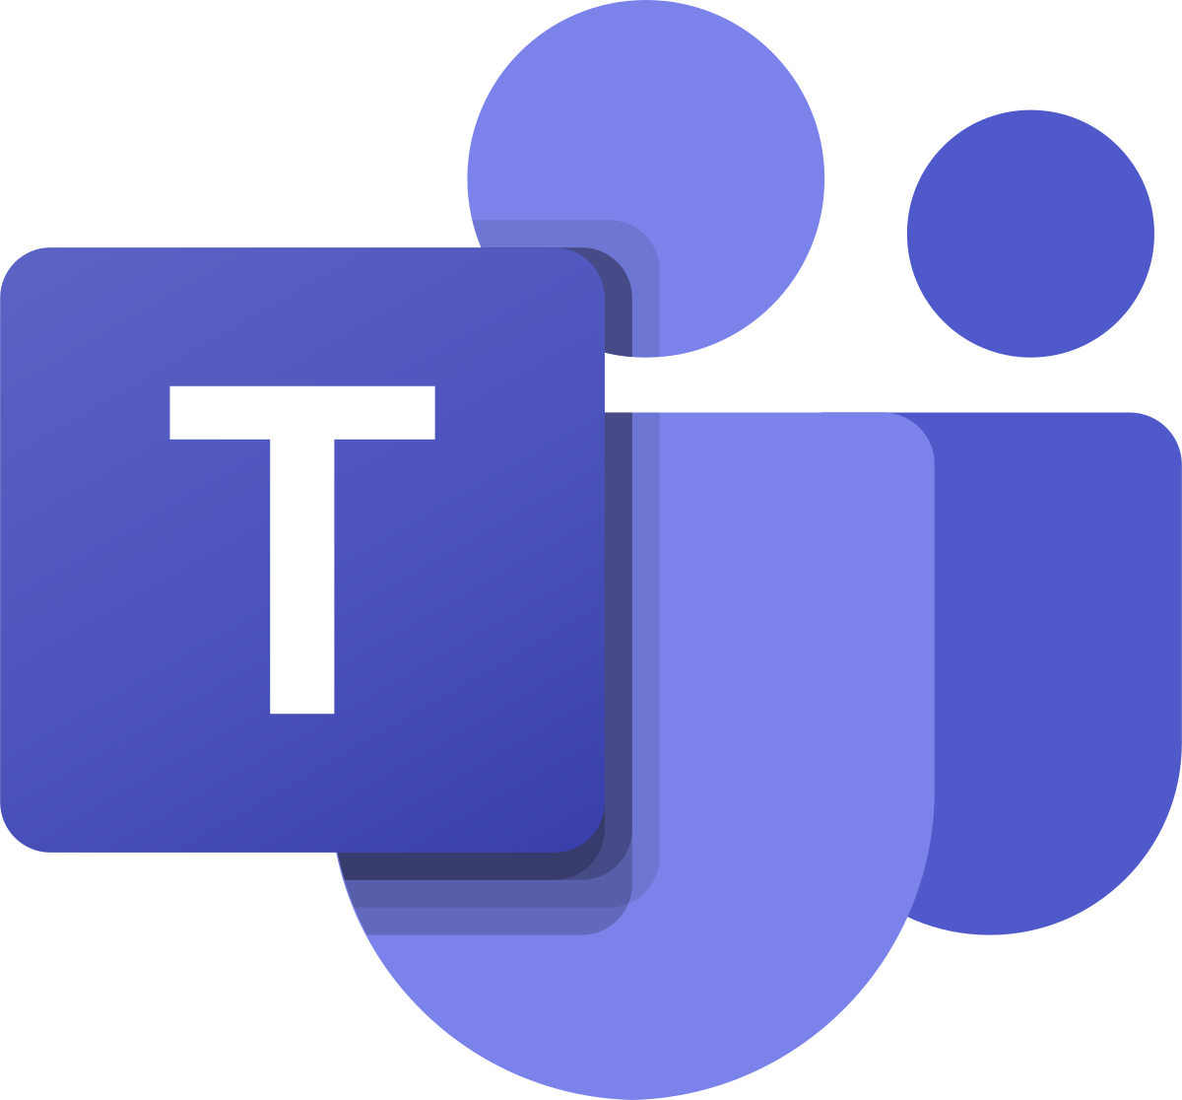

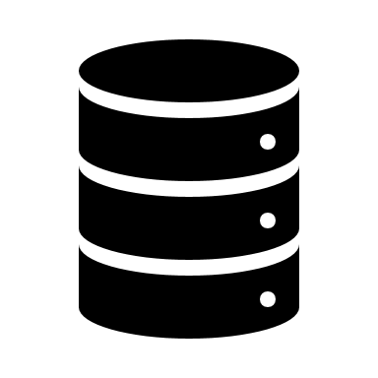
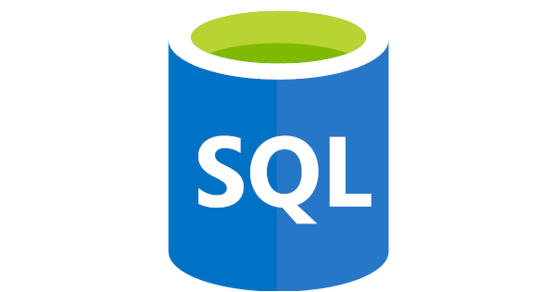
Scalable data modeling and storage options
SQL
SharePoint Online Lists
Dataverse for Teams
Microsoft Dataverse
On Premises
Data
SQL
On Azure
Built and maintained by citizen developers
Connect natively with a standard connector
Good for low volume and simple non-relational data model shared across O365 and Power Platform
Simple Permission Groups managed by IT Professionals and super users
Built and maintained by citizen developers
Connect natively with Microsoft Teams
Good for low volume of relational data structures to use exclusively within Microsoft Teams
One-click upgrade to Dataverse
OMG (Owner, Member, Guest) permissions
Built and maintained by super users
Connect natively with a premium connector¹
Good for large volume of transactional data (Data, Files, Log)
Out-of-the-box multi-language and multi-currency support
Advanced Role Based Access Control (RBAC)
Auto Load-Balancing, Backup, Restore and audit log
Customizable duplicate detection and business rules
Built and maintained by IT professionals
Connect with an On-Premises data gateway¹
Good for connecting to legacy master data and systems
Share same Gateway across Power Apps, Power Automate and Power BI
Can be configured for load balancing
Built and maintained by IT professionals
Connect with a premium connector¹
Good for very large volumes of master data shared with heterogenous systems
Role Based Access Control (RBAC) customizable by IT Professionals
Data Quality Tools and Business rules customizable by IT Professionals
¹Feature requires standalone Power Apps or Power Automate user license
Microsoft Proprietary and Confidential

Slide 4
Scalable data modeling and storage options
 | SharePoint Lists | Dataverse for Teams | Dataverse | On Premises Data | Azure SQL
Maximum data capacity | 25 TB per site collection limits when accessing and operating on lists in an app | 2 GB per environment no option to increase but can upgrade to Dataverse environment | 4 TB per environment | - | 100 TB
Hierarchical security | None | None | Out of the box via Business units | - | Customization
Field level security | None | None | Out of the box | - | Out of the box
Who will create and manage the app and data model? | Business | Business | Business or IT | IT | IT
Data model complexity | Simple or flat | Simple or complex | Simple or complex | Complex | Very complex
Platform | PaaS | SaaS | SaaS | - | PaaS
Advanced analytics and reporting | Simple reporting on non-real time data. Refresh is on a schedule. | Direct Query with security trimming and near real-time updates. | Connects to Data Lake Gen 2 for advanced analytics. Direct Query with security trimming and near real-time updates. | - | Direct Query available for near real-time update.
Microsoft Proprietary and Confidential

Slide 5
Which backend for which scenario?
 | Category | Complexity | Data Structure | App Type | Why?
Kudos for the team | Team Initiative | Low | SharePoint Dataverse for Teams | Canvas App | Not highly relational, data will grow over time. Not sensitive data (simple security model). Very mobile. Low traffic.
Simple calculator | Individual Productivity | Low | SharePoint Excel | Canvas App | Not highly relational. Typically replacing an Excel file and making a calculator mobile friendly and accessible. Not sensitive data (simple security model). Low traffic.
Company news | Organization Wide Initiative | Medium | SharePoint | Canvas App | Not highly relational. Simple security structure (read only for the org, with few contributors). Not sensitive data. High traffic.
Task logging | Simple Business Application | Medium | Dataverse | Canvas or Model | Highly relational. Auditability. Process Management. Sometimes front-end canvas, mid office model driven app. Complex or hierarchical security model.
Health and safety questionnaire | Complex Business Application | High | Dataverse SQL | Canvas or Model | Business Process Flows, Security, Auditability. Highly relational data with multiple references to other tables. Complex data structure, complex security structure.
Vendor submitting certificates or permits | Basic Business Application | Medium | Dataverse | Portal | External access through B2B or other authentication. Complex security structure.
Microsoft Proprietary and Confidential

